Slide 1
Parallel Implementation of CNN for Handwritten Digit Recognition
Jithin Shaji (2023BCS0014) Alex Gijo (2023BCS0023)

Slide 2
What is a CNN?
What is convolution?
Convolution is the process by which local features from an image are extracted by applying a filter that slides across the input. Each filter extracts specific features (edges, textures, etc). There is a different filter for each channel.
Two key features
Path independence - Each neuron processes it’s receptive field independent of others.
Weight sharing - The same filter is applied across the image. Thus reducing parameters compared to a FNN.

Slide 3
Problem Statement and Objectives
Implementing CNNs for MNIST Digit classification in C++.
Implementing complete training capabilities including forward propagation, backprop, and weight initialization and updates.
Identify and parallelize computationally intensive operations using OpenMP to achieve speedup on multi-core devices.

Slide 4
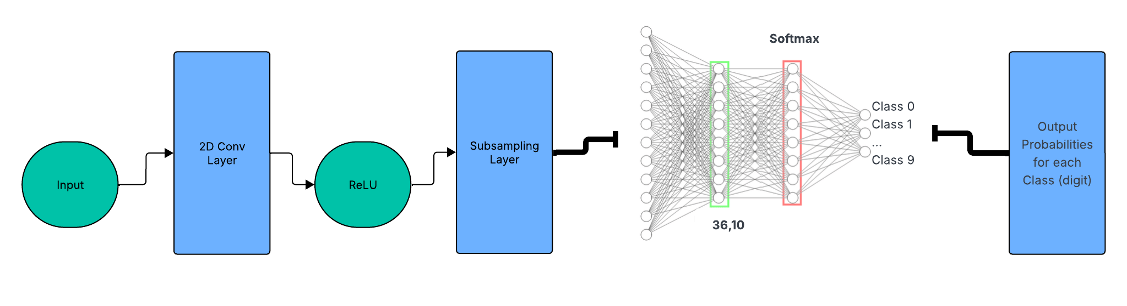
Architecture
We use a Simple LeNet style architecture comprising of:
Conv2D Layer: 1 -> 6 channels, 5×5 kernel (156 parameters)
ReLU Activation
Sub-Sampling Layer (used as pooling): 6 -> 6 channels, 4×4 kernel, stride 4 (486 parameters)
ReLU Activation
Flatten Layer
Linear Layer: 216 -> 10 (2170 parameters)
Softmax Activation (for output probabilities for each class)
Total: ~2812 parameters

Slide 5
Implementation
Header functions
dataloader.h : we need a dataloader similar to the DataLoader class in pytorch for smooth usage of data in the training and inference functions
layers.h : Various functions including forward propagation, backward propagation, gradient or derivative calculation is calculated here.
cnn.h : Tried to replicate the CNN class in nn.modules in pytorch. Has weight updation and initialization function, gradient reset to avoid gradient accumulation, sequential calling of the forward and backward functions implemented in layers.h

Slide 6
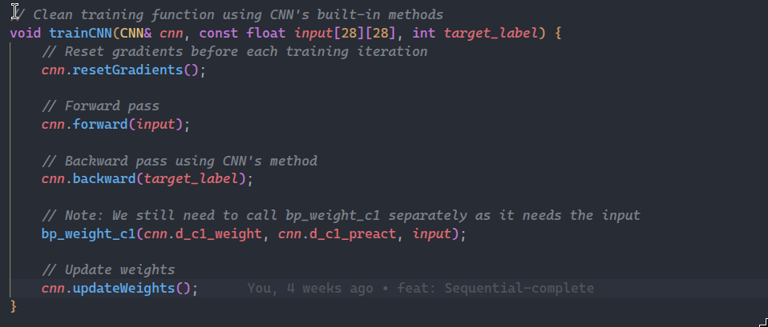
main.cpp
Consists of the training loop functions
Saves the model once training is complete.
Hyperparameters are defined here.

Slide 7
OpenMP Parallelization
Forward Pass: Parallelized matrix multiplications in convolution and fully connected layers to speed up computation.
Activation Functions: Applied activation functions (e.g., ReLU, Sigmoid) in parallel across neurons.
Subsampling Layers: Parallelized pooling operations (average/max) for independent regions of the feature map.
Backward Pass & Gradients: Computed gradients for weights and activations in parallel during backpropagation.
Fully Connected Layer: Parallelized dot product operations for faster output computation.
Weight Initialization: Initialized weights in parallel across layers and neurons for faster setup.
DataLoader: Implemented parallel data loading (similar to PyTorch’s num_workers) to reduce I/O bottlenecks.

Slide 8
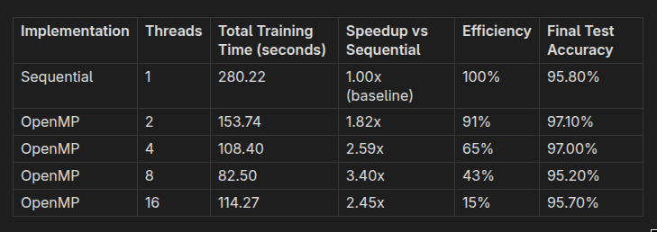
Parallelization Results
The results speak for itself.
When running for 5 epochs with a batch size of 100 with 60k train images and 10k test images.

Slide 9
Key Findings
Sweet Spot at 8 Threads
Maximum speedup of 3.40× achieved with 8 threads
Best training time: 82.50 seconds
Diminishing Returns Beyond 8 Threads
Performance drops with 16 threads, only 2.45× speedup (vs 3.40×)
Caused by thread management overhead.
Activation Functions & Learning Rate Impact
Initially used Sigmoid, matching early CNN architectures
Switched to ReLU (hidden layers) and Softmax (output layer) for modern practice
After switching, accuracy dropped (~18%) and loss increased (~2.3) due to high learning rate (0.1) unsuitable for ReLU
Reducing learning rate to 0.01 drastically improved results: 99.70% training accuracy and 96.80% test accuracy within 5 epochs

Slide 10
Conclusion
The OpenMP parallelization successfully achieved significant performance improvements, with the optimal configuration being 8 threads providing a 3.40x speedup. The implementation demonstrates a good understanding of parallel programming principles, with consistent performance gains through the 2-8 thread range.
The results show that careful tuning is required for optimal performance, and that more threads do not always equal better performance. Note More threads can mean more performance for a more deeper CNN with multiple conv layers.
In the future, this project can be extended to Cuda, which would require us to define our own custom C++ vector class and move out of the stl vector class we use as Cuda works with memory addresses only. This requires a deep-understanding of GPU architecture and C++ and is to be completed when that is achieved first.

Slide 11

THANK YOU

